Slide 1
Wireless Communications and Diversity
Module 1:

Slide 2
Mobile Communication
It means sending and receiving information (voice, text, images, video, internet data) without wires, using mobile phones or other wireless devices. It works through radio waves and networks like 2G, 3G, 4G, and now 5G.
1970s–80s: First mobile phones (1G) – only voice calls, big and heavy.
1990s: 2G – digital calls + SMS.
2000s: 3G – internet and video calls started.
2010s: 4G – fast internet, apps, video streaming.
2020s: 5G – super-fast speed, low delay, smart devices, IoT.

Slide 3
Who developed mobile phones?
Dr. Martin Cooper (Motorola engineer) made the first handheld mobile phone in 1973.
  He is called the “Father of the mobile phone.”
  His first call was made on a Motorola DynaTAC (it was very big and heavy).

Slide 4
Where did the idea come from?
The idea came from radio communication in the early 1900s. Ships, police, and the military were already using big wireless radios.
People wanted a personal wireless phone to talk without being tied to wires.
Scientists thought: If we divide areas into small zones (cells) with antennas, we can reuse frequencies and allow many people to talk at the same time.
This is called the cellular concept (invented by engineers at Bell Labs in 1947).

Slide 5
Example
Imagine you are in a city traveling in a car and talking on your mobile phone.
When you start, your phone connects to the nearest tower (cell).
As your car moves, the signal shifts smoothly from one tower to the next (handover).
You don’t notice the change, your call continues without breaking.
This works because the city is divided into cells with antennas, just like small zones.
Without this cellular idea, only a few people could talk at once. But with cells, millions of people in one city can use mobiles at the same time.

Slide 6
Advanced Mobile Communication
It means the latest and improved ways of sending voice, text, images, and data through mobile phones using modern wireless technologies.
Unlike old systems (just for calls), advanced mobile communication gives us:
Fast internet (4G, 5G)
Video calls & streaming
Online gaming & apps
Smart devices connection (IoT - smart cars, smart homes, smart healthcare)
Low delay (latency) so actions happen instantly

Slide 7
Wireless Communication
It means sending information without wires, using signals like radio waves, Wi-Fi, Bluetooth, or infrared.
Example: Using mobile phones, Wi-Fi internet, or Bluetooth headphones.
Diversity (in Wireless Communication)
“Diversity” means using more than one path or method to send/receive signals, so the connection stays strong, even if one path is weak.
Example:
Your phone may use two antennas. If one antenna’s signal is weak, the other gives a better signal.
In Wi-Fi, your device may pick the strongest signal from different routes.
In short:
Wireless = communication without wires.
Diversity = using multiple signals/paths to avoid call drops or poor internet.

Slide 8
How Diversity Works in Wireless Communication
When a signal travels in the air, it can become weak because of obstacles (like buildings, walls, rain, etc.).
To avoid poor quality, diversity uses multiple versions of the same signal (different paths, antennas, or frequencies).
The receiver (like your phone) then chooses the best signal or combines them for better quality.
Real-Life Example
You’re in a train using mobile internet.
Your phone has two antennas (this is called antenna diversity).
If one antenna gets a weak signal because a building blocks it, the other antenna might still catch a strong signal.
Your phone automatically switches or combines them → so your call or video keeps working smoothly.
In short:
Diversity = backup paths for signals. If one is bad, another is used → so communication stays strong and clear.

Slide 9
Fast Fading Wireless Channel Modeling
Fading = when the signal becomes weak or changes while traveling from the tower to your phone.
Why fading happens?
Because signals don’t always travel in a straight line, they bounce, bend, or spread.
Because signals bounce (reflection), bend (diffraction), or spread (scattering) and may cancel each other or lose strength.
Example
You are on a call inside a moving car. Sometimes the voice breaks or the internet slows down → that’s because the signal is fading.
Fading = ups and downs in signal strength. (Rapid Changes)
Channel = Path for Signal
  A wireless channel is just the path the signal takes from transmitter (tower) to receiver (phone).
Why Modeling?
  To study and predict how signals behave (we can’t see signals, so we use math + models to simulate them).

Slide 10
Real-Life Examples
You’re watching YouTube on your phone while traveling in a fast-moving train.
Sometimes the video buffers suddenly for a moment, then becomes clear again.
This happens because the signal is fast fading (the channel strength is changing quickly due to movement + reflections).
In short:
Fast Fading Wireless Channel Modeling = making models to understand how signals quickly change in strength when people or objects move fast.

Slide 11
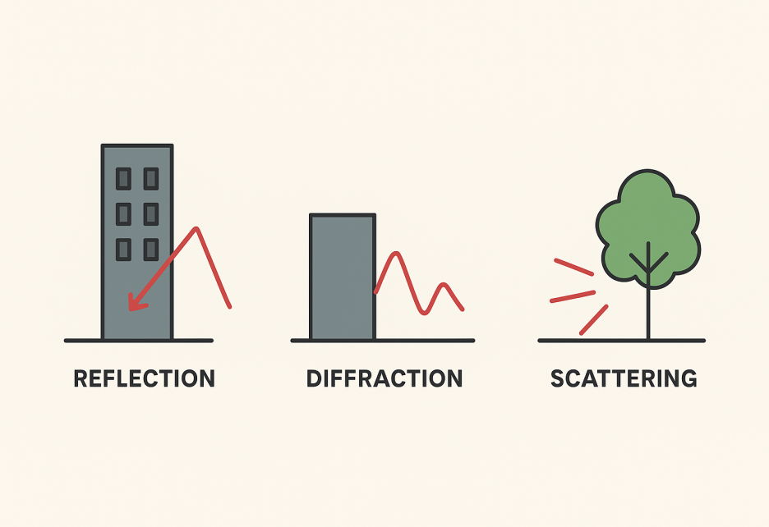
Building wall → Reflection (bounce)
Corner of tall building → Diffraction (bend)
Trees and small objects → Scattering (spread)

Slide 12
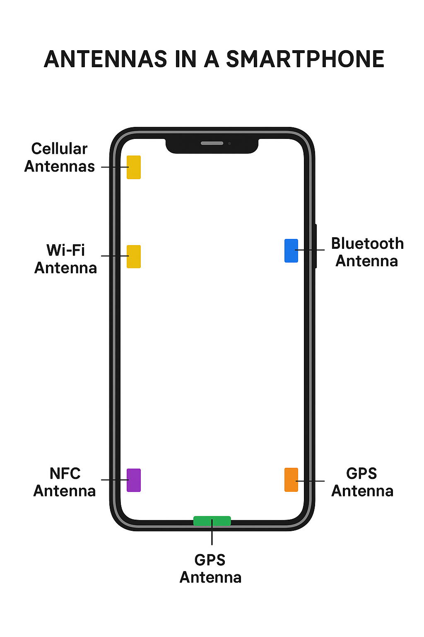
Example:
A 5G smartphone may have:
  4 antennas for 5G/4G
  2 antennas for Wi-Fi
  1 antenna for GPS
  1 antenna for Bluetooth
  = 8 antennas in total (hidden inside the phone).

Slide 13
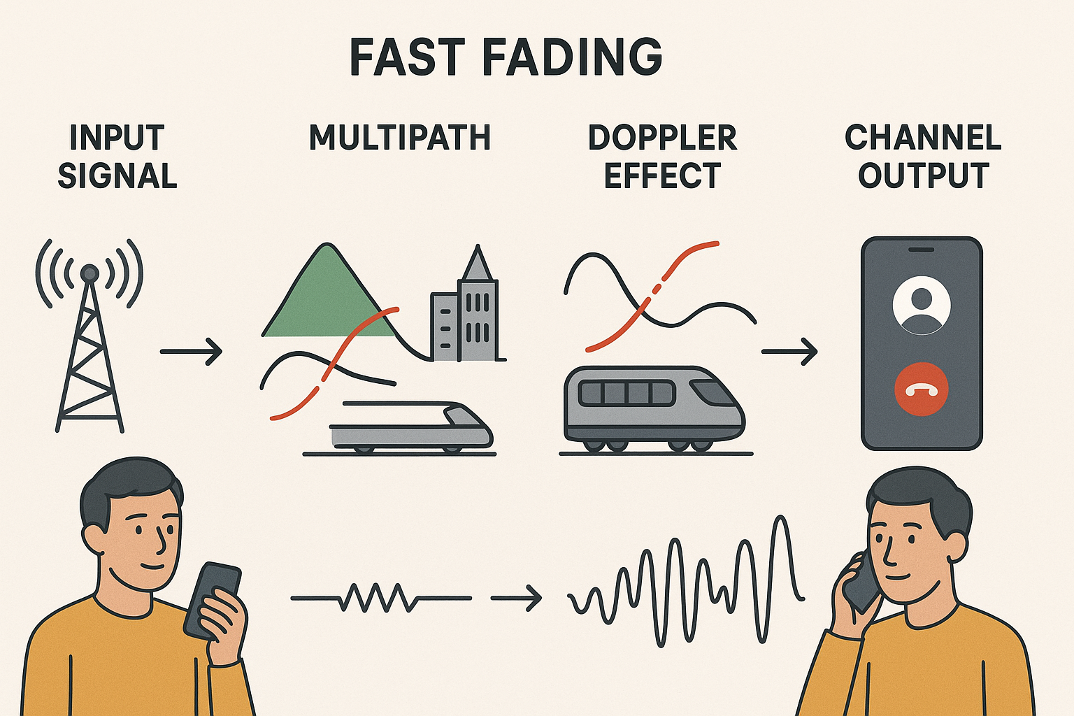

Slide 14
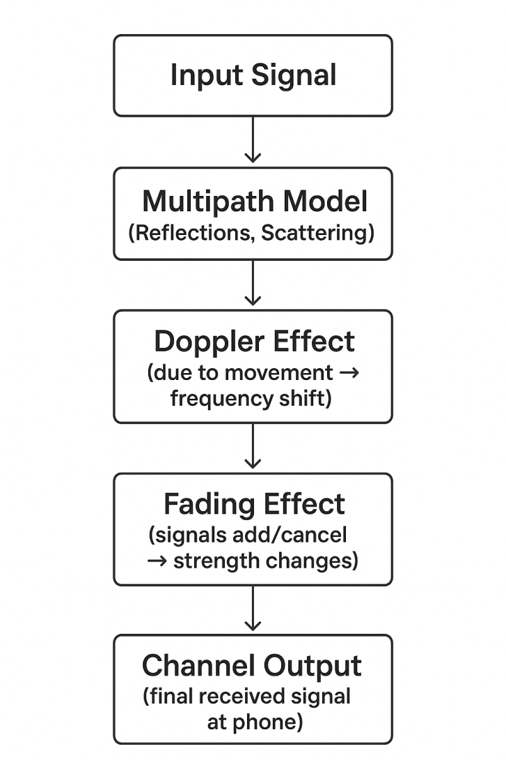
Fast Fading Wireless Channel Modeling Block Diagram

Slide 15
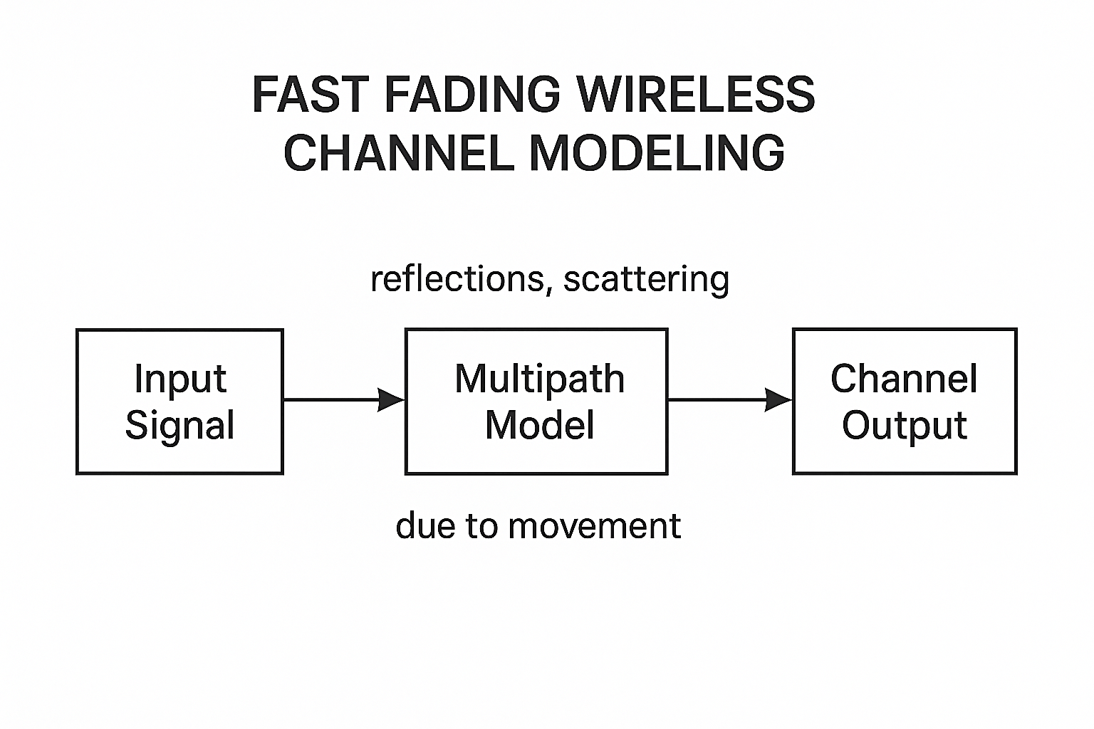
1. Input Signal
This is the original transmitted signal (voice, data, video, etc.).
Example: A mobile base station transmits a digital voice signal to your phone.
2. Multipath Model (Reflections, Scattering)
The signal does not travel in a straight line only; instead, it bounces off buildings, trees, vehicles, etc.
This creates multiple copies of the same signal, each arriving at slightly different times and phases.
Example: Your phone receives one signal directly, another reflected from a building, another scattered by a moving bus.

Slide 16
3. Doppler Effect (due to movement)
If you are moving (car, train, bike), the frequency of signals changes.
The shift depends on speed → Faster movement → faster frequency shifts.
Example: If you’re in a car moving at high speed, the received signals fluctuate much more rapidly compared to when you’re walking.
4. Fading Effect (mixing of signals)
  The multiple signals from multipath combine at your phone.
  Sometimes they add up → strong signal, sometimes they cancel → weak signal.
  Because of Doppler, this adding/canceling happens very quickly → called fast fading.
  Example: When you’re on a bike, your music streaming sometimes plays smoothly (signal strong) and sometimes buffers suddenly (signal weak).

Slide 17
5. Channel Output (final received signal)
The final received signal after multipath + Doppler effect.
It is a distorted version of the input: amplitude, phase, and frequency vary with time → this is fast fading.
  This is what finally reaches your phone.
  It keeps changing rapidly in strength → sometimes clear, sometimes weak.
  Example: During a call in a moving car, the voice may sound clear for a moment, then cut for a second, because of fast fading.
In simple words:
The tower sends a clean signal → it bounces around (multipath) → your movement shifts its frequency (Doppler) → signals add or cancel (fading) → your phone gets a signal that keeps going up and down (fast fading).

Slide 18
Line-of-Sight (LOS)
LOS means there is a clear, straight path between the transmitter (tower) and the receiver (phone).
No big obstacles (like buildings, hills, or walls) in between.
Example:
If you are standing in an open field and can see the tower directly, that’s Line-of-Sight (LOS).
If you are behind a tall building and can’t see the tower, that’s Non-Line-of-Sight (NLOS).
LOS = direct view → strong signal.
NLOS = blocked view → weaker signal (depends on reflections, bending, scattering).

Slide 19
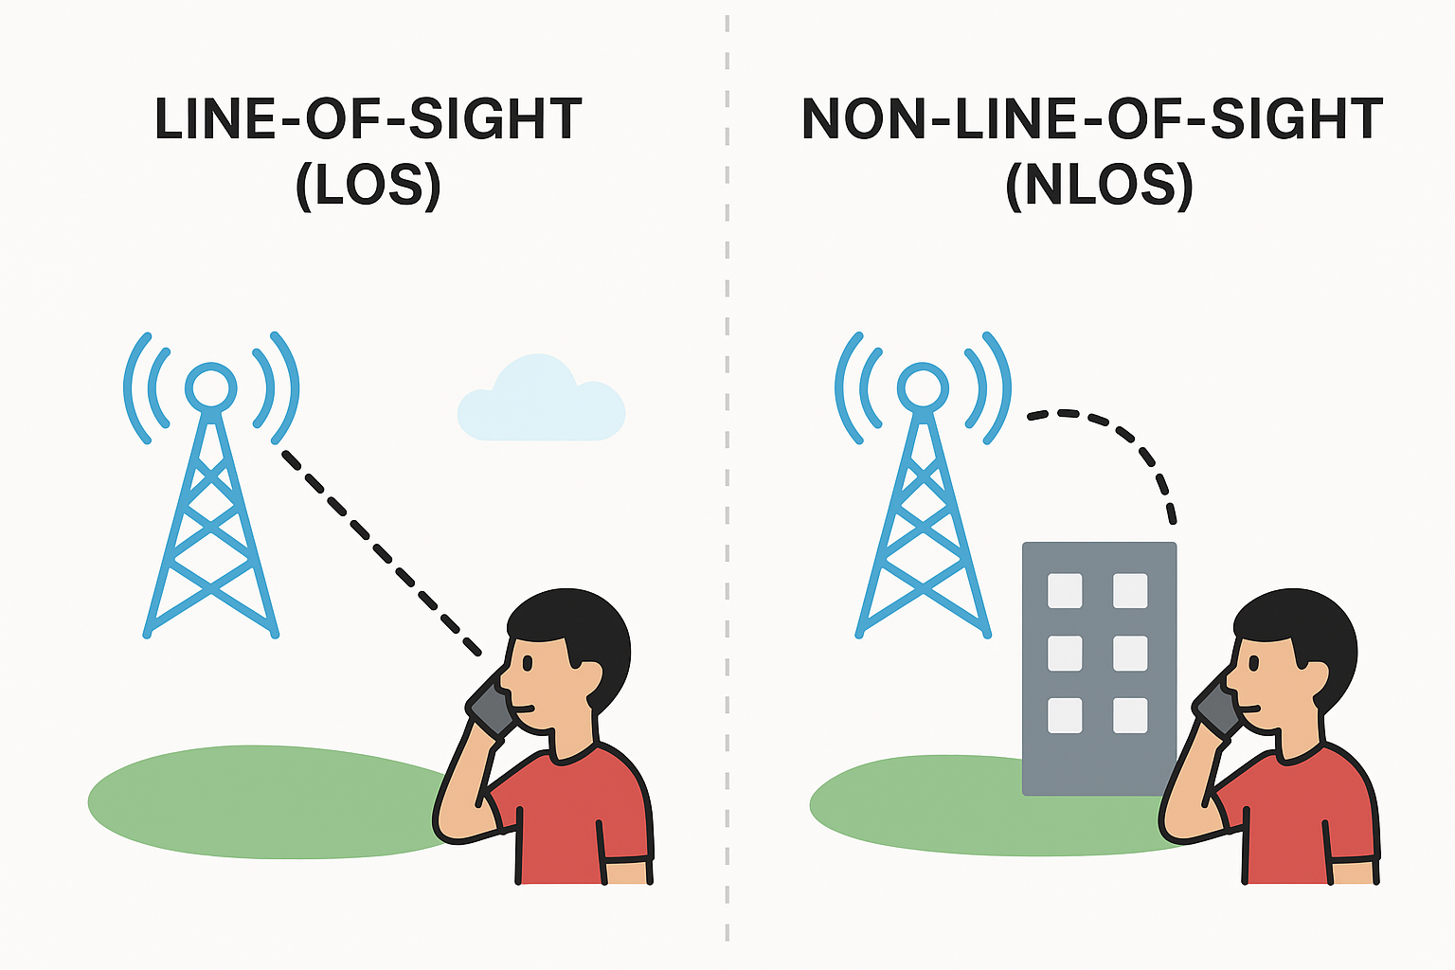

Slide 20
Rayleigh Fading Channel
Happens when there is no direct Line-of-Sight (LoS) between transmitter and receiver.
Signal reaches through reflections, scattering, and diffractions.
The received signal strength keeps changing randomly.
Example:
A mobile user in a city with tall buildings → the signal comes only after bouncing from many buildings (no direct path).
You’re on a city street between tall buildings making a phone call. The tower is not visible. Your phone receives only reflected signals → strength fluctuates a lot, sometimes dropping.

Slide 21
Rician Fading Channel
Happens when there is a direct Line-of-Sight (LoS) path plus many reflected/scattered paths.
The direct signal is usually stronger, so fading is less severe compared to Rayleigh.
Example:
A mobile user in an open area where the tower is visible, but still some reflections from trees or cars exist.
You’re on a video call in an open ground where the tower is visible. Your phone gets a clear direct signal plus a few small reflections → signal is more stable and quality is better.

Slide 22
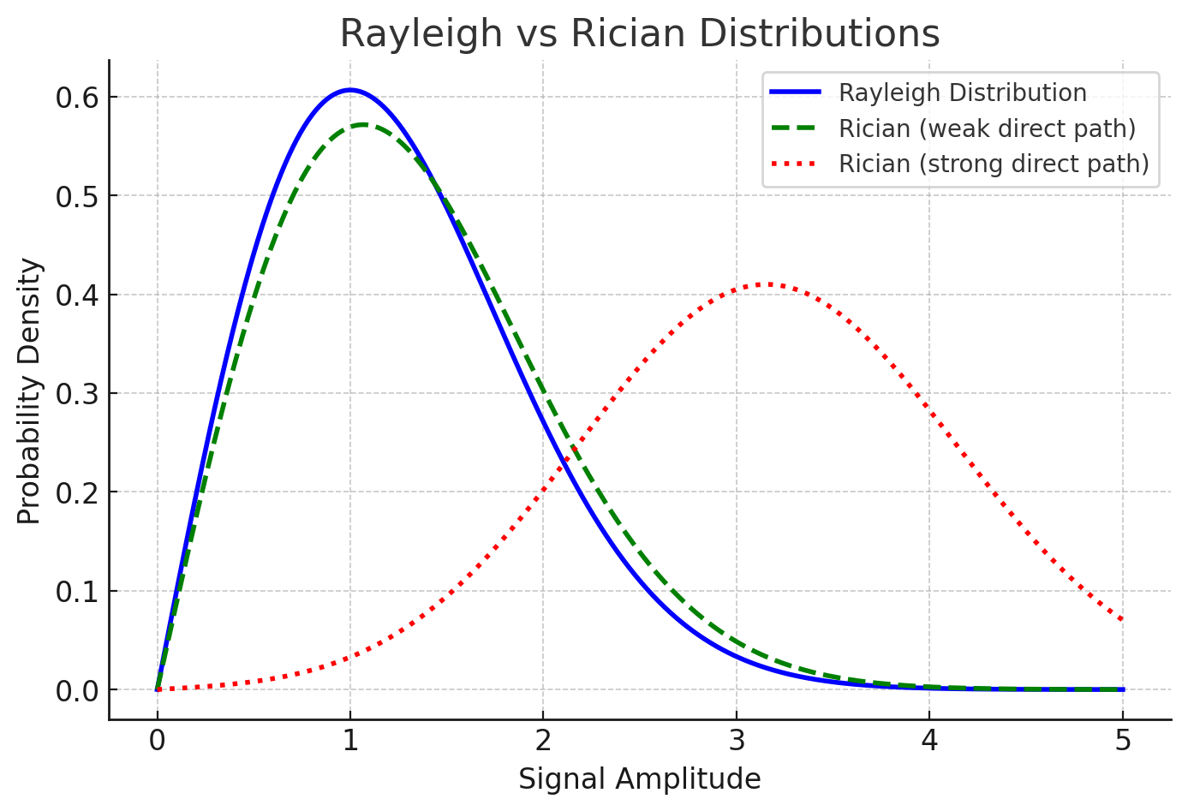
Rayleigh distribution and Rician distribution

Slide 23
Rayleigh distribution and Rician distribution
Blue curve (Rayleigh Distribution)
  Used when no direct path exists.
  Signal comes only from reflections → random, centered near small amplitudes.
Green curve (Rician with weak direct path)
  Direct path exists, but is weak.
  Shape is close to Rayleigh, but slightly shifted.
Red curve (Rician with strong direct path)
  Direct path is strong.
  The distribution shifts toward higher amplitudes (more stable and stronger signal).
Rayleigh = no direct signal → weaker, random.
Rician = direct signal + reflections → stronger, more stable.

Slide 24
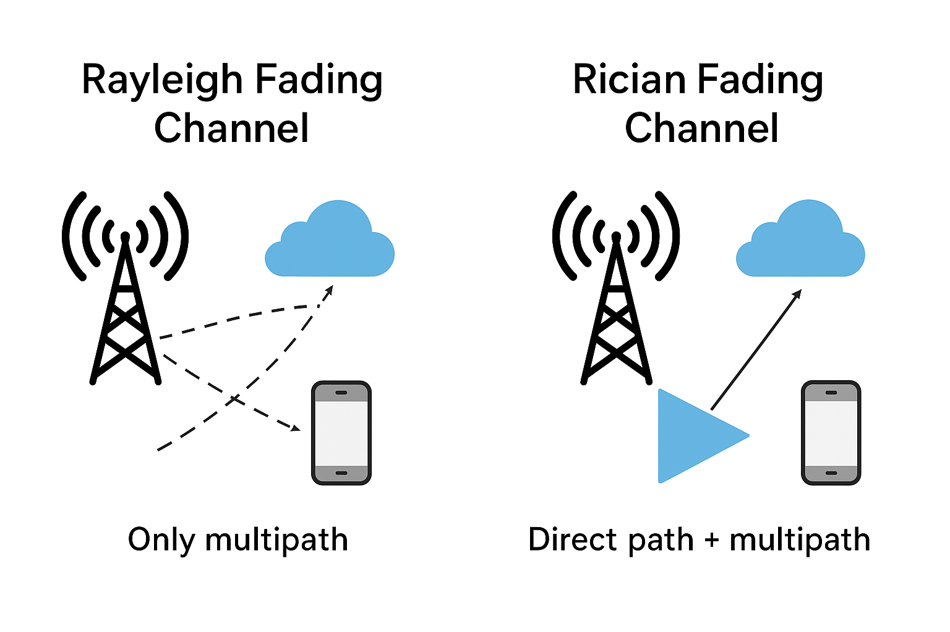
Fading Channel Types

Slide 25
Rayleigh Fading Channel diagram
The signal from the tower does not reach directly to the phone.
It only comes after bouncing (multipath) from buildings, clouds, etc.
So, the signal strength keeps changing a lot → can be weak or strong depending on reflections.
Example: In a crowded city with tall buildings where the tower is not visible.

Slide 26
Rician Fading Channel diagram
The signal from the tower has a direct path to the phone.
Along with the direct path, there are also reflected signals (multipath).
The direct path makes the signal more stable compared to Rayleigh fading.
Example: In an open area where you can see the tower, but still some reflections from trees or cars exist.
In short:
Rayleigh = only multipath, no direct signal.
Rician = direct signal + multipath.

Slide 27
Feature | Rayleigh Fading | Rician Fading
LOS Path | No line-of-sight (only reflections) | Strong line-of-sight + reflections
Cause | Signal arrives only via scattering, reflection, diffraction | Signal arrives via direct path + multipath
Distribution | Rayleigh distribution | Rician distribution
Environment | Dense urban areas, indoors | Suburban, open areas, highways
Signal Quality | Highly unstable, deep fades common | More stable, fewer deep fades
Example | Phone call in a crowded city street with tall buildings | Video call in an open ground with tower in view

Slide 28
BER Performance in Fading Channels
BER (Bit Error Rate)
BER = how many bits are received wrong compared to total bits sent.
Lower BER = better communication quality.
What is Fading?
Fading = when a wireless signal becomes weak or distorted because of obstacles, reflections, or movement.
Causes errors in received data.
BER in Fading Channels
In fading channels, BER increases because signals become unreliable.
More noise, weaker signals → more bit errors.
How to Improve BER in Fading?
Diversity techniques (Frequency, Time, Space).
Error correction codes.

Slide 29
Real-Life Example:
While using mobile internet in a moving car:
  At some places (open road), the signal is strong → fewer errors (low BER).
  In tunnels or near tall buildings, the signal fades → more errors (high BER).
In fading channels, BER is worse because signal strength keeps changing.
Rician fading (with LOS path) → medium performance.
Rayleigh fading (no LOS path) → worst performance.
BER TELLS US HOW MANY TRANSMITTED BITS BECOMES WRONG DURING COMMUNICATION.

Slide 30
Diversity modeling for Wireless Communications
In wireless systems, signals often get weak or distorted because of:
Fading (signal strength going up and down),
Noise,
Interference,
Obstacles (like buildings, trees, etc)
Diversity is a technique used to improve signal quality and reliability by sending/receiving the same information in different ways (like different paths, times, or frequencies).
If one path is bad, another might be good → so overall communication improves.
Example: Using two antennas, if one signal fades, the second antenna helps maintain the call.

Slide 31
Problem in Wireless:
Signals often get weak due to fading, noise, or obstacles.
This causes call drops, slow internet, or unclear reception.
Solution – Diversity:
Send or receive the same signal in different ways.
If one way fails, another succeeds → improves reliability.
How it Helps:
  Reduces errors,
  Improves call quality,
  Increases internet speed reliability.
  Example:
  In mobile phones, multiple antennas (MIMO) are used so if one signal path is blocked
  by a building, another path still carries the signal → call remains clear.
In short:
Diversity modeling = sending the same signal in multiple ways (time, frequency, space) so that wireless communication stays strong and clear.
Diversity in wireless is like having backup routes for your signal – if one fails, another saves the communication.

Slide 32
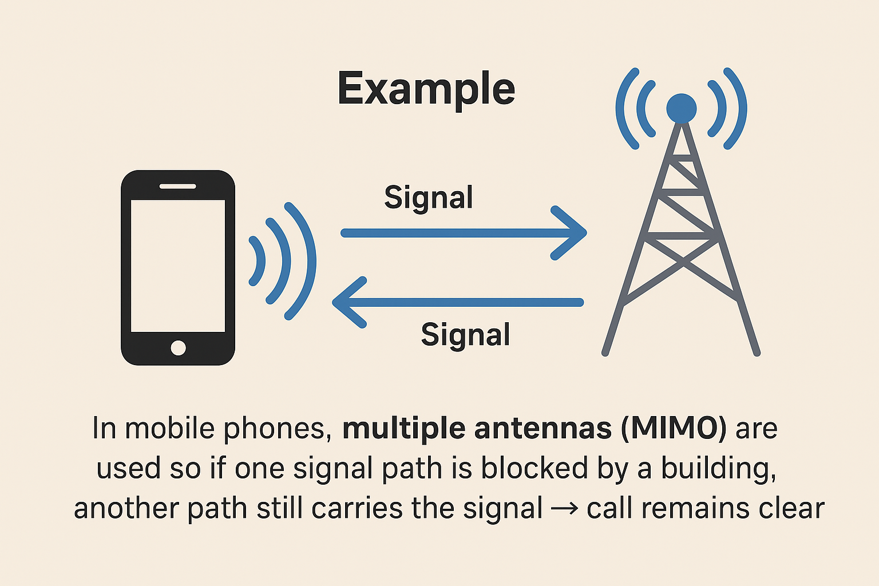
Diversity modeling for Wireless Communications

Slide 33
BER Performance Improvement with diversity
What is BER?
  BER = Bit Error Rate → number of wrong bits received / total bits sent.
  Lower BER = better communication quality.
Problem in Wireless:
  Wireless signals face fading, noise, and interference.
  This increases BER (more errors in received bits).
How Diversity Helps:
  By sending/receiving the same signal in different ways (time, frequency, space), the chance of all signals being bad at once is very low.
  Receiver combines these signals → fewer errors → BER reduces.
Example:
  Without diversity: A mobile phone in a city gets one weak signal → voice breaks, BER is high.
  With antenna diversity (MIMO): Even if one path fades, another carries the data. Receiver selects/combines best signals → BER drops → voice call is clear.
Key Benefit:
  Diversity = backup paths.
  More reliable communication, fewer errors, smoother internet and calls.
  Diversity reduces BER because even if one signal is disturbed, others provide correct data, improving overall communication quality.

Slide 34
Real-Life Example
When you watch YouTube on 4G/5G:
If only one antenna/path is used, video may buffer (high BER).
With multiple antennas (diversity), the phone gets multiple signals. If one is disturbed, another is clear → BER is reduced → video plays smoothly.

Slide 35
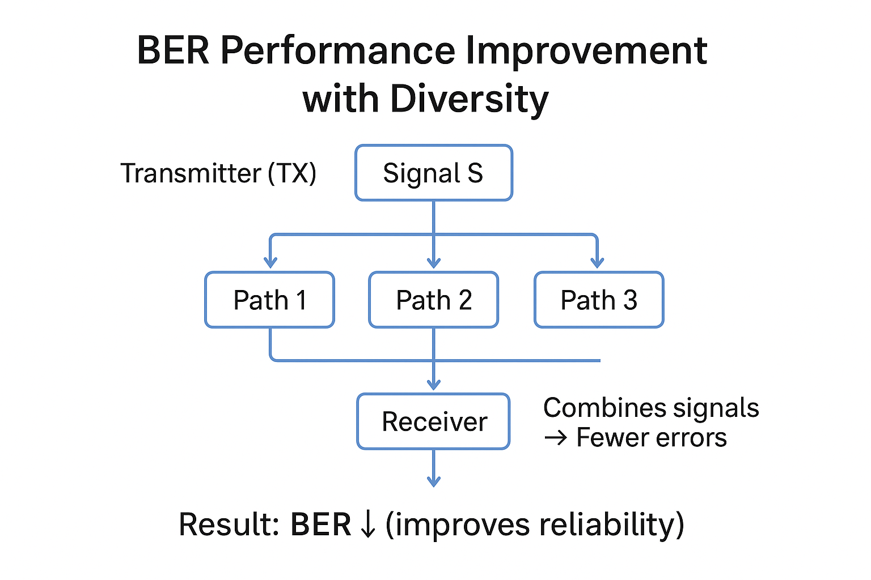

Slide 36
Types of Diversity
1. Frequency Diversity
Meaning: Send the same information over two or more different frequencies.
Reason: Wireless channels may have noise or fading at some frequencies, but not all.
How it helps: If one frequency is weak, the receiver can still get the data from the other.
Real-Life Example: FM Radio broadcasting – a station may transmit on nearby frequencies, so even if one suffers interference, listeners can still tune in clearly.

Slide 37
2. Time Diversity
Meaning: Send the same signal at different times.
Reason: Wireless channels change over time due to movement, weather, or obstacles.
How it helps: If the channel is bad at one instant, it may be good later.
Real-Life Example: Wi-Fi or mobile data retransmissions – when a packet is lost due to poor signal, it is automatically re-sent to ensure error-free communication.

Slide 38
3. Space Diversity (Antenna Diversity)
Meaning: Use multiple antennas placed at different positions (on transmitter, receiver, or both).
Reason: Signals may fade or get blocked at one antenna, but another antenna may still receive them strongly.
How it helps:
  Reduces signal fading (more reliable signal).
  Improves data speed (parallel paths used).
  Reduces call drops (always at least one clear signal).
Real-Life Example:
  4G/5G mobile phones with MIMO (Multiple Input Multiple Output) use several antennas.
  This allows faster internet speed, stable video calls, and fewer dropped connections.
  Wi-Fi routers with 2 or 3 antennas also use this to give stronger coverage in a house.

Slide 39
